Slide 1
Bio-medical Image Processing
Dr. R. Devika Rubi

Slide 2
CAD (Computed Aided Diagnosis) Method
When cancer symptoms actually appear, it becomes too late to diagnose
It is overcome by
Computer Aided Diagnosis Method
Computer Aided Detection Systems
CAD may help in early detection of cancer
Supported by number of s/w tools for the enhanced classification and optimization
Helps physicians/radiologists working towards to identify missed details
Recent research contributions suggest that CAD algorithm successfully expose breast masses and micro-calcification (small white cancer spot)

Slide 3
CAD system
Image Enhancement
Image Segmentation
Feature Extraction
Classification
Report

Slide 4
Image Enhancement
Used to improve the quality of an image as perceived by a human as well as by a machine
Broadly classified as
Spatial domain methods
Contrast Stretch
Histogram modification
Density Slicing
Edge Enhancements
Spatial Filtering
Frequency domain methods
Smoothing domain
Sharpening domain filters

Slide 5
Image Enhancement…
Following are the factors degrade the image quality
Poor illumination and lighting
Improper pose condition
Noise signal
Sufficient brightness (or) contrast level can be achieved using suitable image enhancement techniques

Slide 6
Image Segmentation
In diagnosis process ,the correct region which is affected need to be separated
It is essential that we can distinguish between the RoI and the remaining portion (eg. cancerous tissue vs non-cancerous tissue)
A good segmented image can be justified on the basis of statistical analysis
The method (or) technique used to find RoI (Region of Interest) is called segmentation technique

Slide 7
Feature Extraction
A process which helps in extracting suitable features of any image processing technique
For eg. In case of breast cancer detection, size, shape and other features help in the exact detection of the affected region and classification of the various possibilities in an image of breast
1st Order Statistical Features – Size, Shape, Intensity
2nd Order Statistical Features – Haralick, Reiez
Geometric Features – Area, perimeter, compactness, Shape

Slide 8
Classification
To classify the detected suspicious areas of the distinct categories
Sample images of lower grade gliomas showing (a) a grade-2 anaplastic astrocytoma and (b)a grade-3 oligodendroglioma

Slide 9
Glioma Classification
Three features distinguishing glioblastomamultiforme (GBM), (a)Vascularthrombosis, (b)Microvascularproliferation (MVP) and (c) Pseudopalisading-Necrosis.

Slide 10
Example of CAD system – LGG vs GBM

Slide 11
Evaluation parameters of CAD System
Efficiency of CAD system can be determined on the basis of number of statistical parameters
Some of the parameters used in the evaluation
True Positive (TP) : Identify abnormality for the diseased person
True Negative (TN) : No detection of abnormality in healthy person
False Positive (FP): Abnormality is found in healthy person
False Negative (FN): Abnormality is not found in diseased person
FP and FN are critical parameters
FP requires an invasive examination which implies patient anxiety, stress, unnecessary costs
FN is even worse, compromises the health of patient and the disease treatment
Sensitivity = TP / (TP+FN), a higher value indicate minimal FN detection
Specificity = TN/ (TN+FP), a higher value indicate FP detection
Accuracy = (TP+TN) / (TN+TP+FP+FN)
Precision = TP / (TP+FP)

Slide 12
CAD System : Image Enhancement Technique
If the quality of images (that are subjected to CAD system or manual examination by the radiologist) is poor then the possibility of wrong decision will be always there
Image enhancement is to process an image so that the result is more suitable than the original image for a specific application – Face recognition, cancer detection etc
An analyst initially, has to discriminate between the areas having a small difference in the density
It requires suitable image enhancement method

Slide 13
Spatial Domain Methods
It directly operate over pixels and modification is made over the intensity values of the pixels
Expressed by a transformation function
e(x,y) = T(f(x,y))
Where e(x,y) is the processed image or enhanced image, f(x,y) is input image and T is operator over f, in the neighborhood of (x,y)
Also be referred as s = T[r], where s is enhanced image, r is the intensity of input image, T is the operator over input image
Contrast stretching - The effect of this transformation is to produce an image of high contrast as compared to the original image by darkening the level below m and brightening the level above m in the original image
Point processing – This transformation produces a same level of intensity in the output image at the location of some (x,y)

Slide 14
Contrast Stretching vs Point Stretching
Dark Light Dark Light
m
m

Slide 15
Linear Transformation vs Non-linear Transformation
Change in the intensity values of the enhanced image is directly proportional to the change in the intensity value of the input image, then the transformation is linear, else the transformation is non-linear
Linear contrast enhancement is expressed as y=f(x), where x is an input image and y is output image

Slide 16
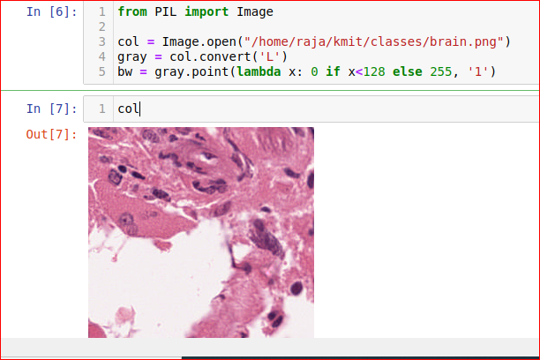
Spatial Domain operations
Binary image operation
The pixels having only two possible values 0 and 1
Displayed as Black and White
Often produced by separating an object in the image from the background
Color of the object is referred to as foreground color and the remaining are as known as the background color

Slide 17
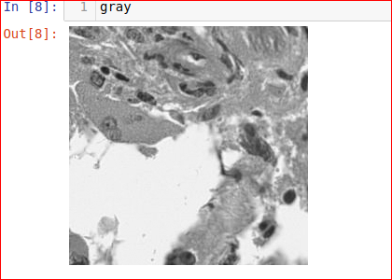
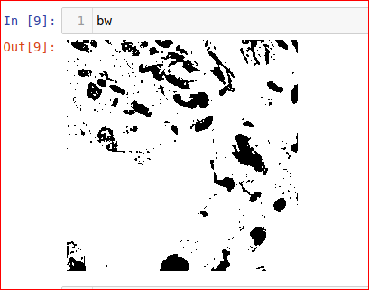

Slide 18
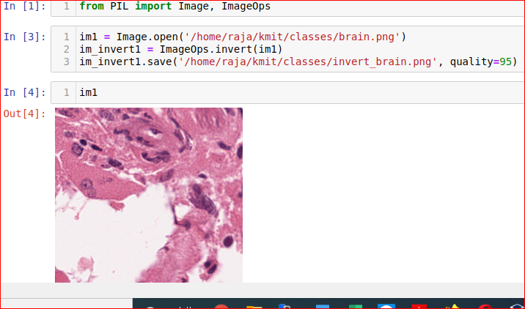
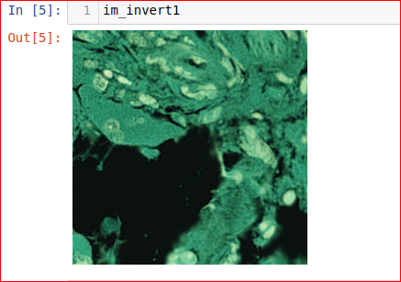
Negative or Invert Transformation
Defined as
s=L -1 – r,
where s is the enhanced image, L is the highest range of grayscale value and r is the intensity of input image
Basic idea is to reverse the grayscale value from black to white so that the intensity of the output image decreases as the intensity of input increases
i.e. lighter pixels become darker, darker pixels become lighter

Slide 19
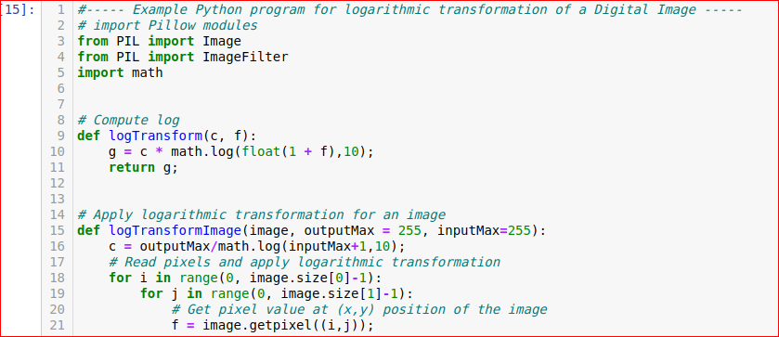
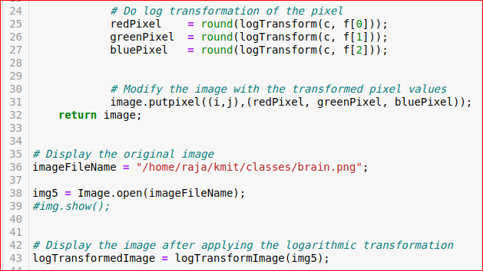
Log Transformation
General form of Log Transformation is
S = C * log(1 + r)
Where s is the output image, C is the constant and r is the intensity of image
This transformation maps a narrow range of grayscale value in the input image onto a wider range of output level and the opposite is also true

Slide 20
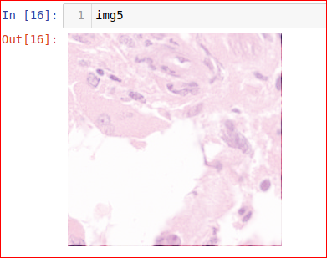
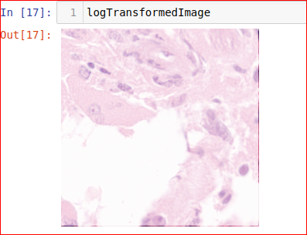

Slide 21
Contrast Enhancement
Used to improve contrast of an image
Features or details which are not clear in original image are now clear in the contrast-enhanced image
The transformation is
s = p * (r ^ y), where p = 1, y = 0.1, 0.9, 5, 10
Performance is improved by identifying lower and upper bounds of the enhanced transformation of the gray input image
The expression for improved contrast enhancement is
s1 = (s – c) * [ (b – a) /(d – c) ]
Where s1 is output image, s is the enhanced image, a, b are the lower and upper bounds of gray scale values, c and d are the lower and upper bounds of the enhanced image

Slide 22
Contrast Enhancement
Used to improve contrast of an image by expanding or stretching the range of intensity values
Features or details which are not clear in original image are now clear in the contrast-enhanced image
It involves identifying lower and upper bounds from the histogram of an input image
The expression for contrast enhancement is
s = (r – c) * [ (b –a) /(d – c) ] + α
Where s is the output image, r is input image a, b are the lower and upper bounds of gray scale values, c and d are the lower and upper bounds from the histogram of original image

Slide 23
Contrast Enhancement ….
Number of pixels is plotted against the intensity value is known as histogram
It observes the relationship between the gray values of original value and the enhanced image
Improves the contrast of an image with the light areas appearing lighter and the dark areas appearing darker
The possible α values are 0.15, 0.3 and 0.45

Slide 24
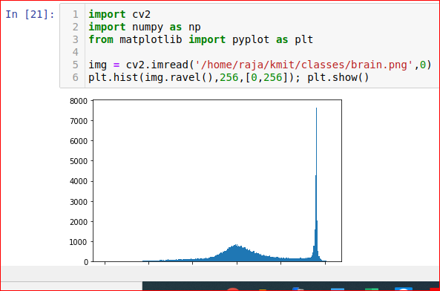
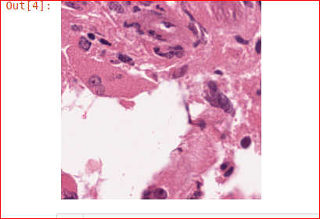
Histogram of an image
Histogram
Original Image

Slide 25
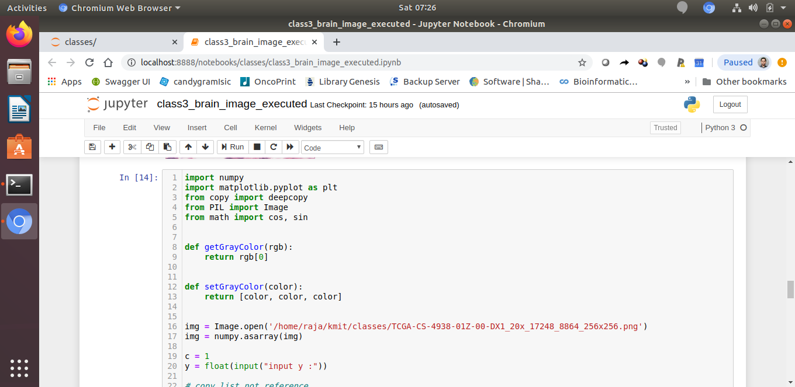
Contrast Enhancement

Slide 26
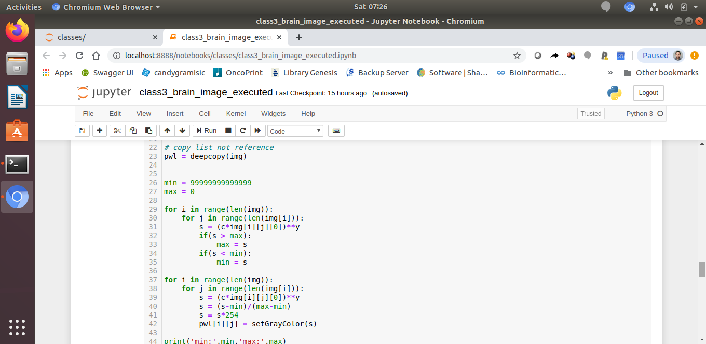
Contrast Enhancement

Slide 27
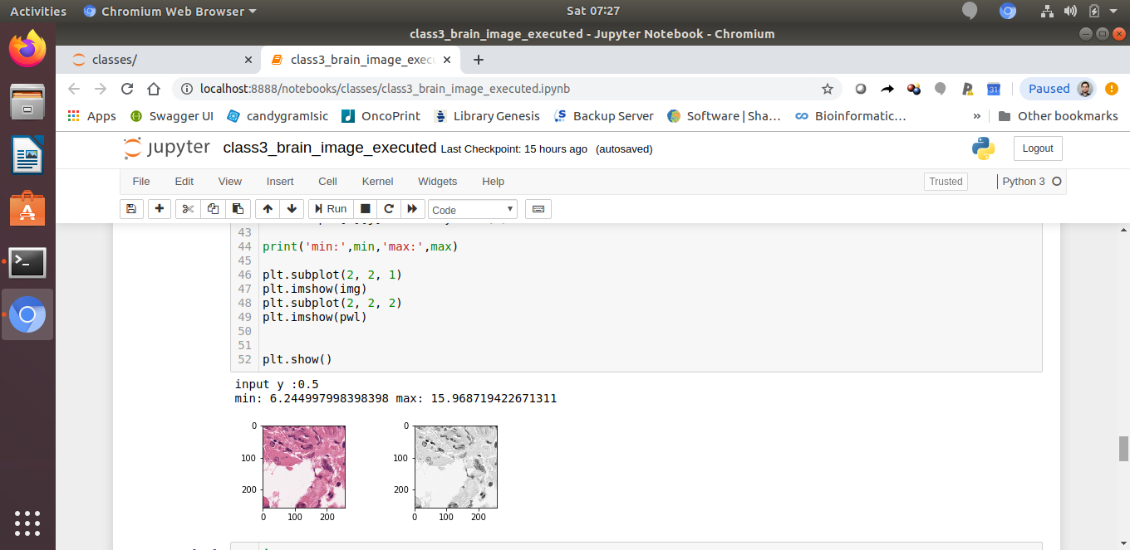
Contrast Enhancement

Slide 28
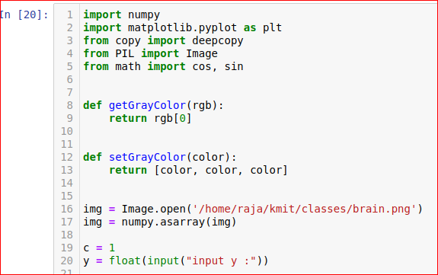
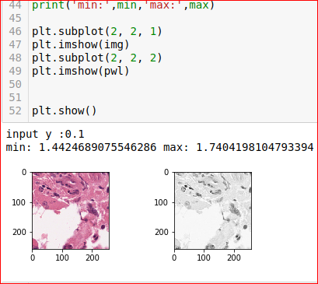
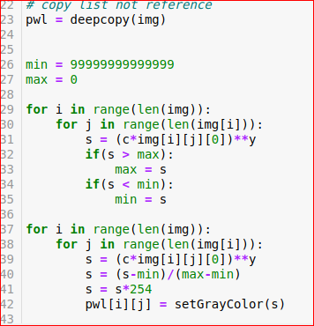

Slide 29
Image as Signal
According to the IEEE Transactions on Signal Processing, a signal can be audio, video, speech, image, sonar and radar-related and so on
Any imaging device will allow light onto to its sensor
Light is a wave, which has a frequency, wavelength, etc
Different wavelengths/frequencies (Frequency Domain) correspond to different colors which is an analog signal
When sensor detects "signal" it converts it into a digital equivalent by sampling and quantizing, i.e. detects it as a set of RGB values (Spatial domain)
So an image is nothing more than a digital representation of light which is a wave with the context in which it's called a signal

Slide 30
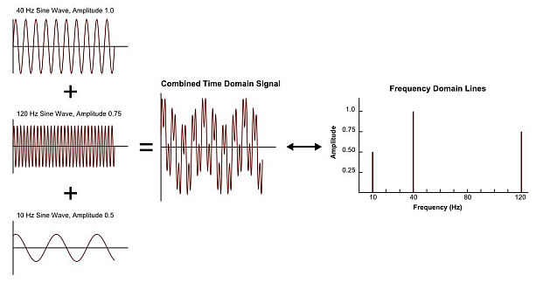
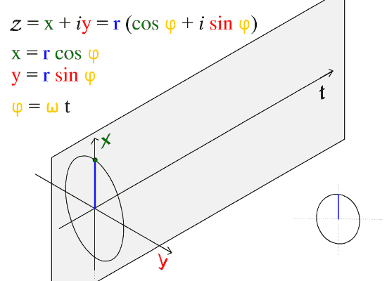
Frequency Domain
Frequency domain analysis is used to indicate how signal energy can be distributed in a range of frequency
This Photo by Unknown Author is licensed under CC BY-SA

Slide 31
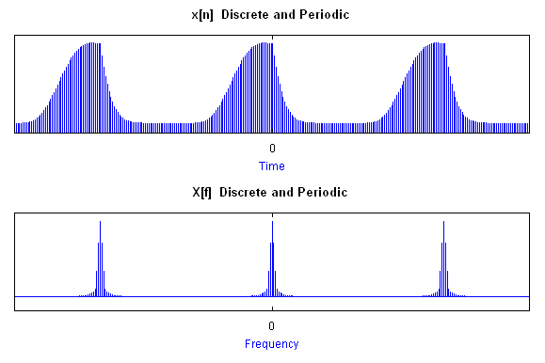
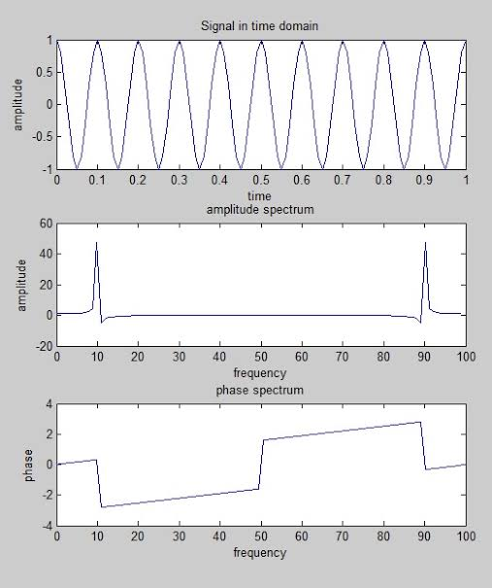
Spatial Domain vs Frequency Domain

Slide 32
Fourier Transform
Switch between the spatial and Fourier (i.e frequency) domain
Used to decompose an image into its sine (imaginary) and cosine (real) components i.e. an array of complex numbers
The output of the transformation represents the image in the Fourier or frequency domain, while the input image is the spatial domain equivalent (Forward FFT), and vice versa (Inverse FFT)
The Fourier Transform is used in a wide range of applications, such as image analysis, image filtering, image reconstruction and image compression

Slide 33
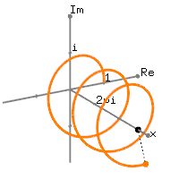
Fourier Transform
The Fourier Transform produces a complex number valued output image which can be displayed with two images, either with the real and imaginary part or with magnitude and phase

Slide 34
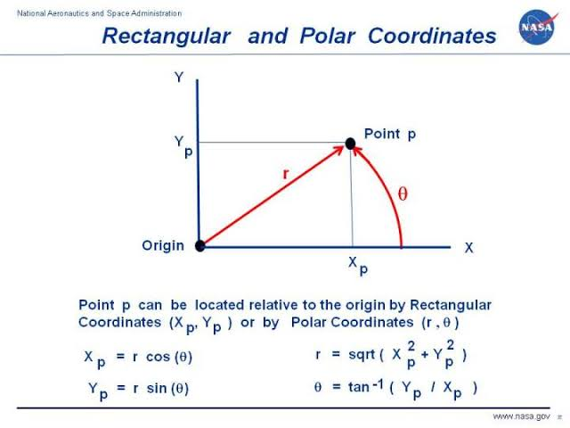
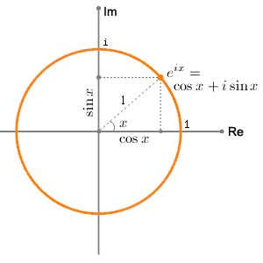
Cartesian Coordinates and Polar Coordinates
Euler’s Formula

Slide 35
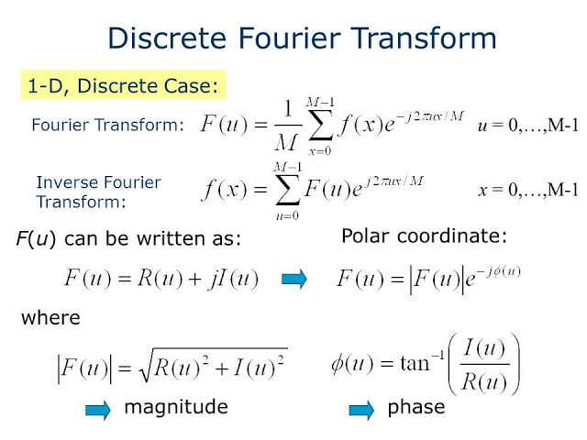
DFT for 1-Dimensional
dft_idft.ipynb

Slide 36
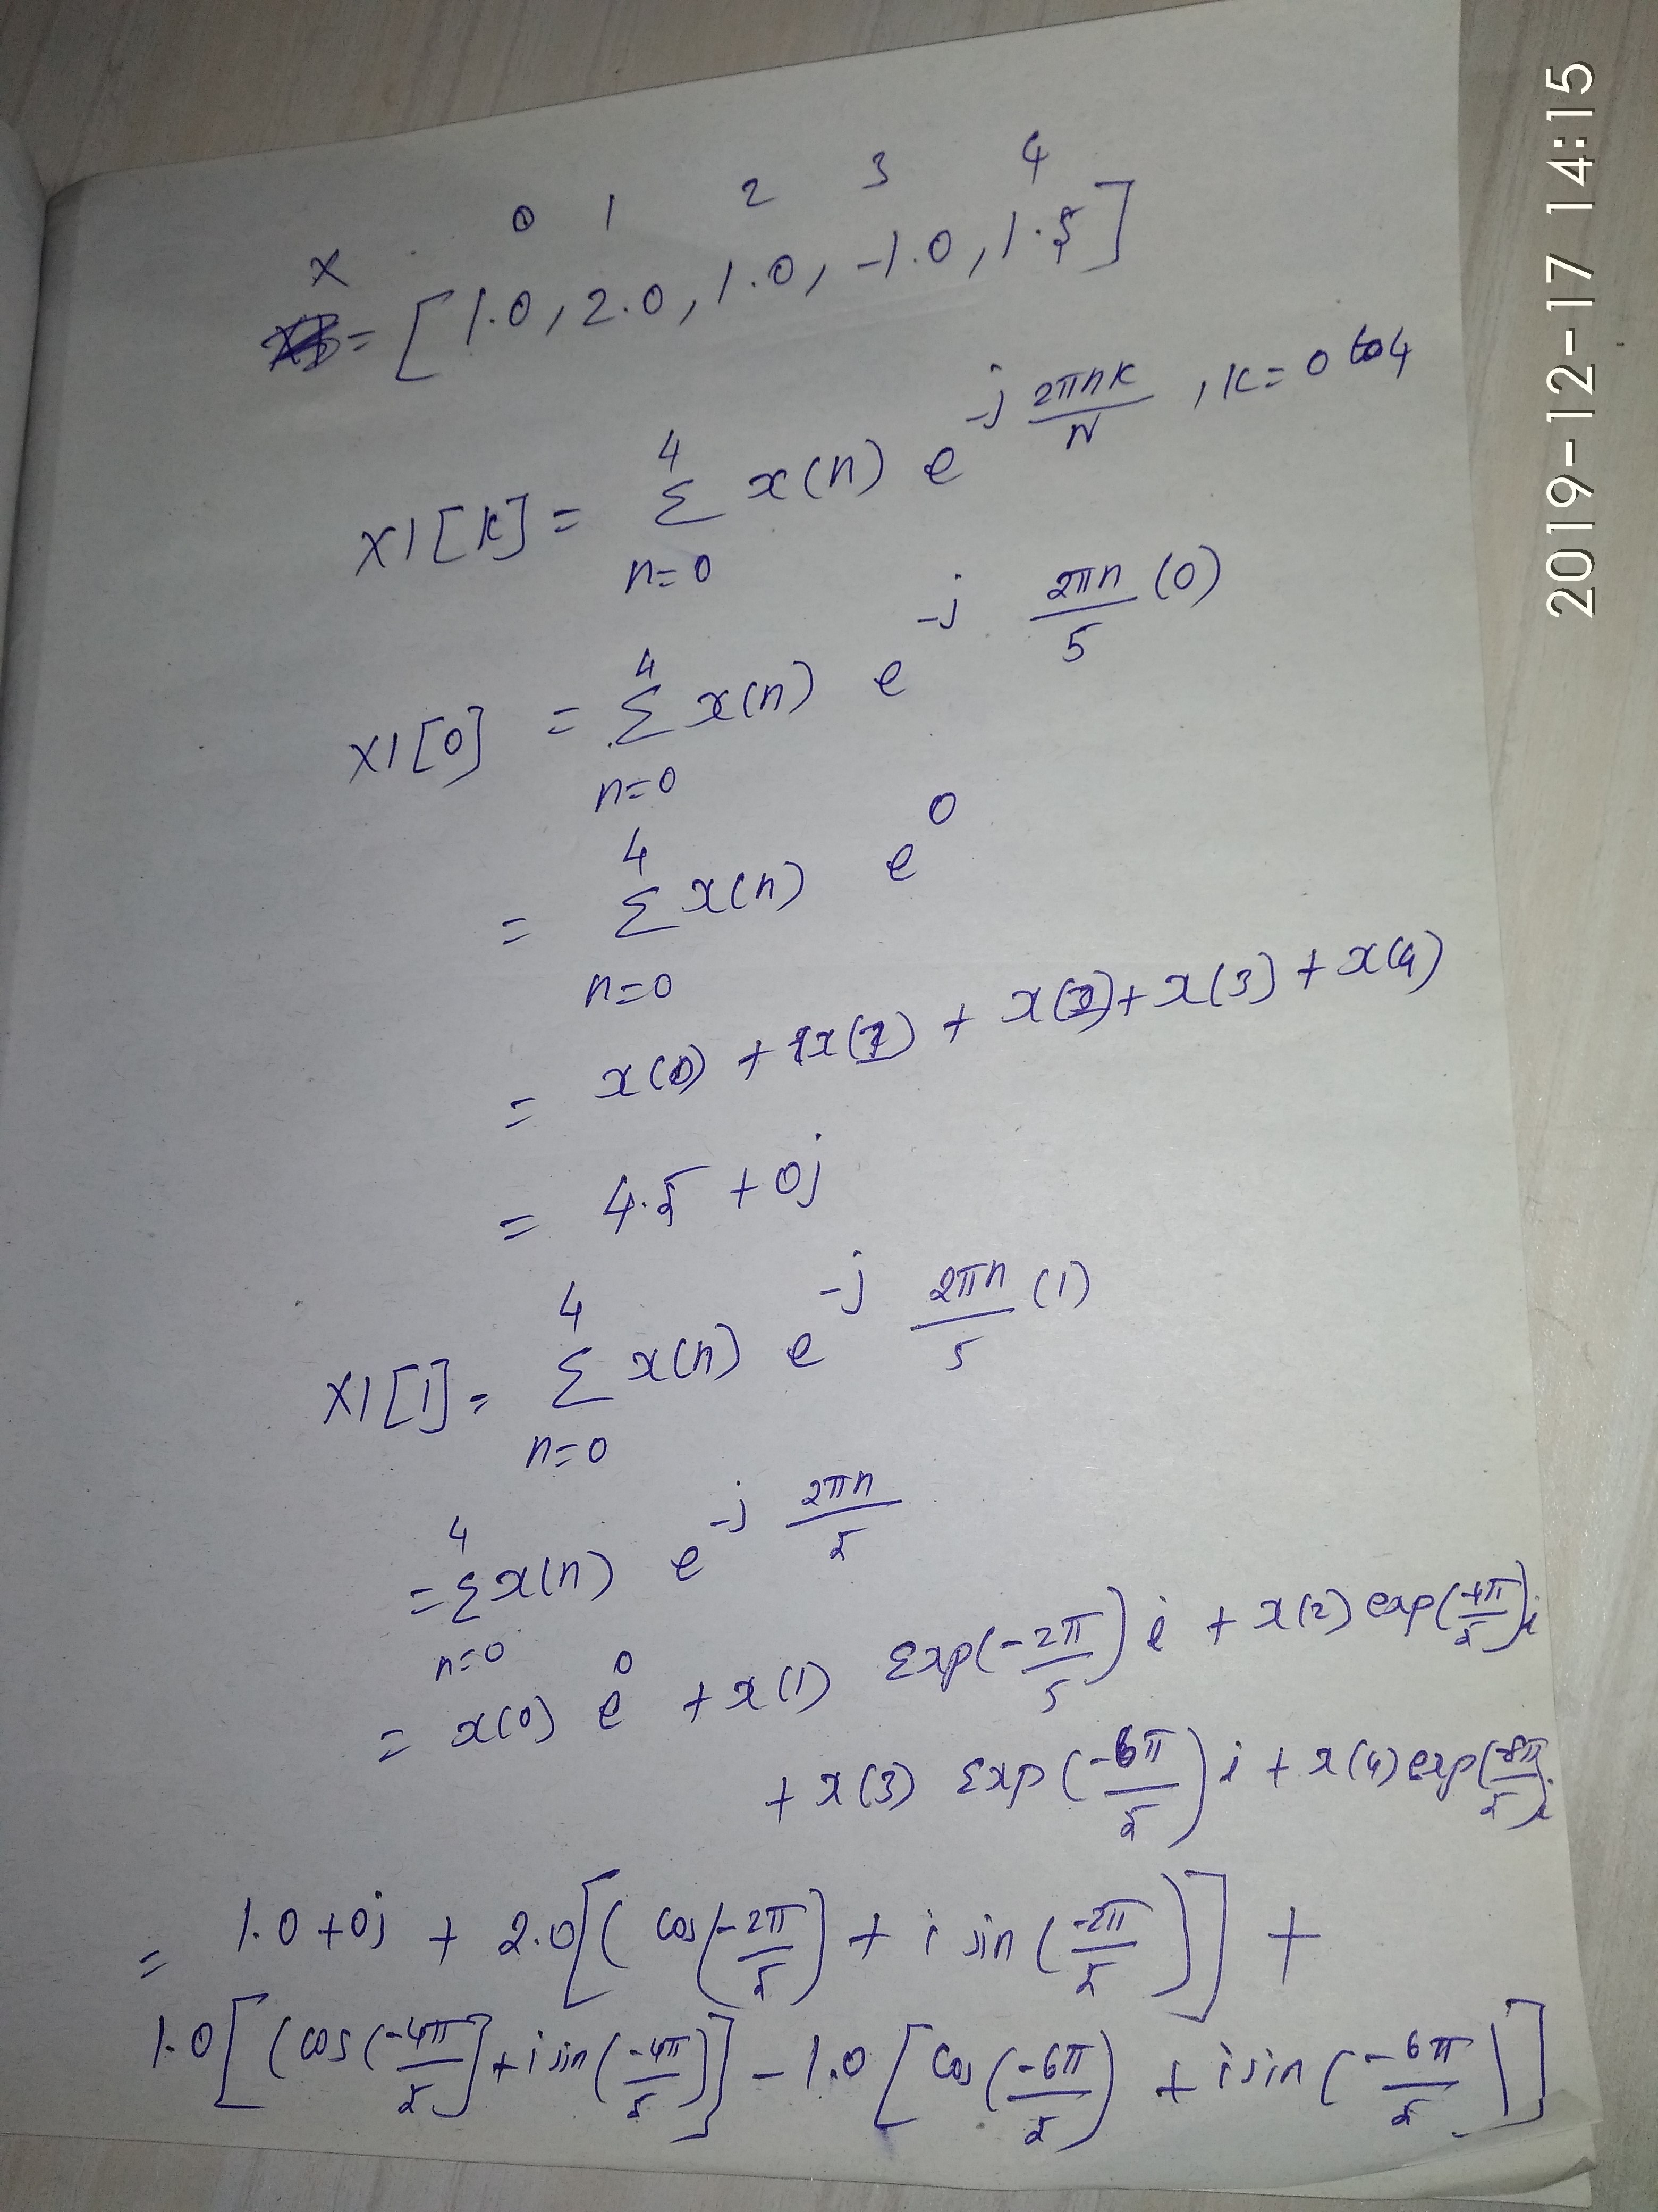

Slide 37
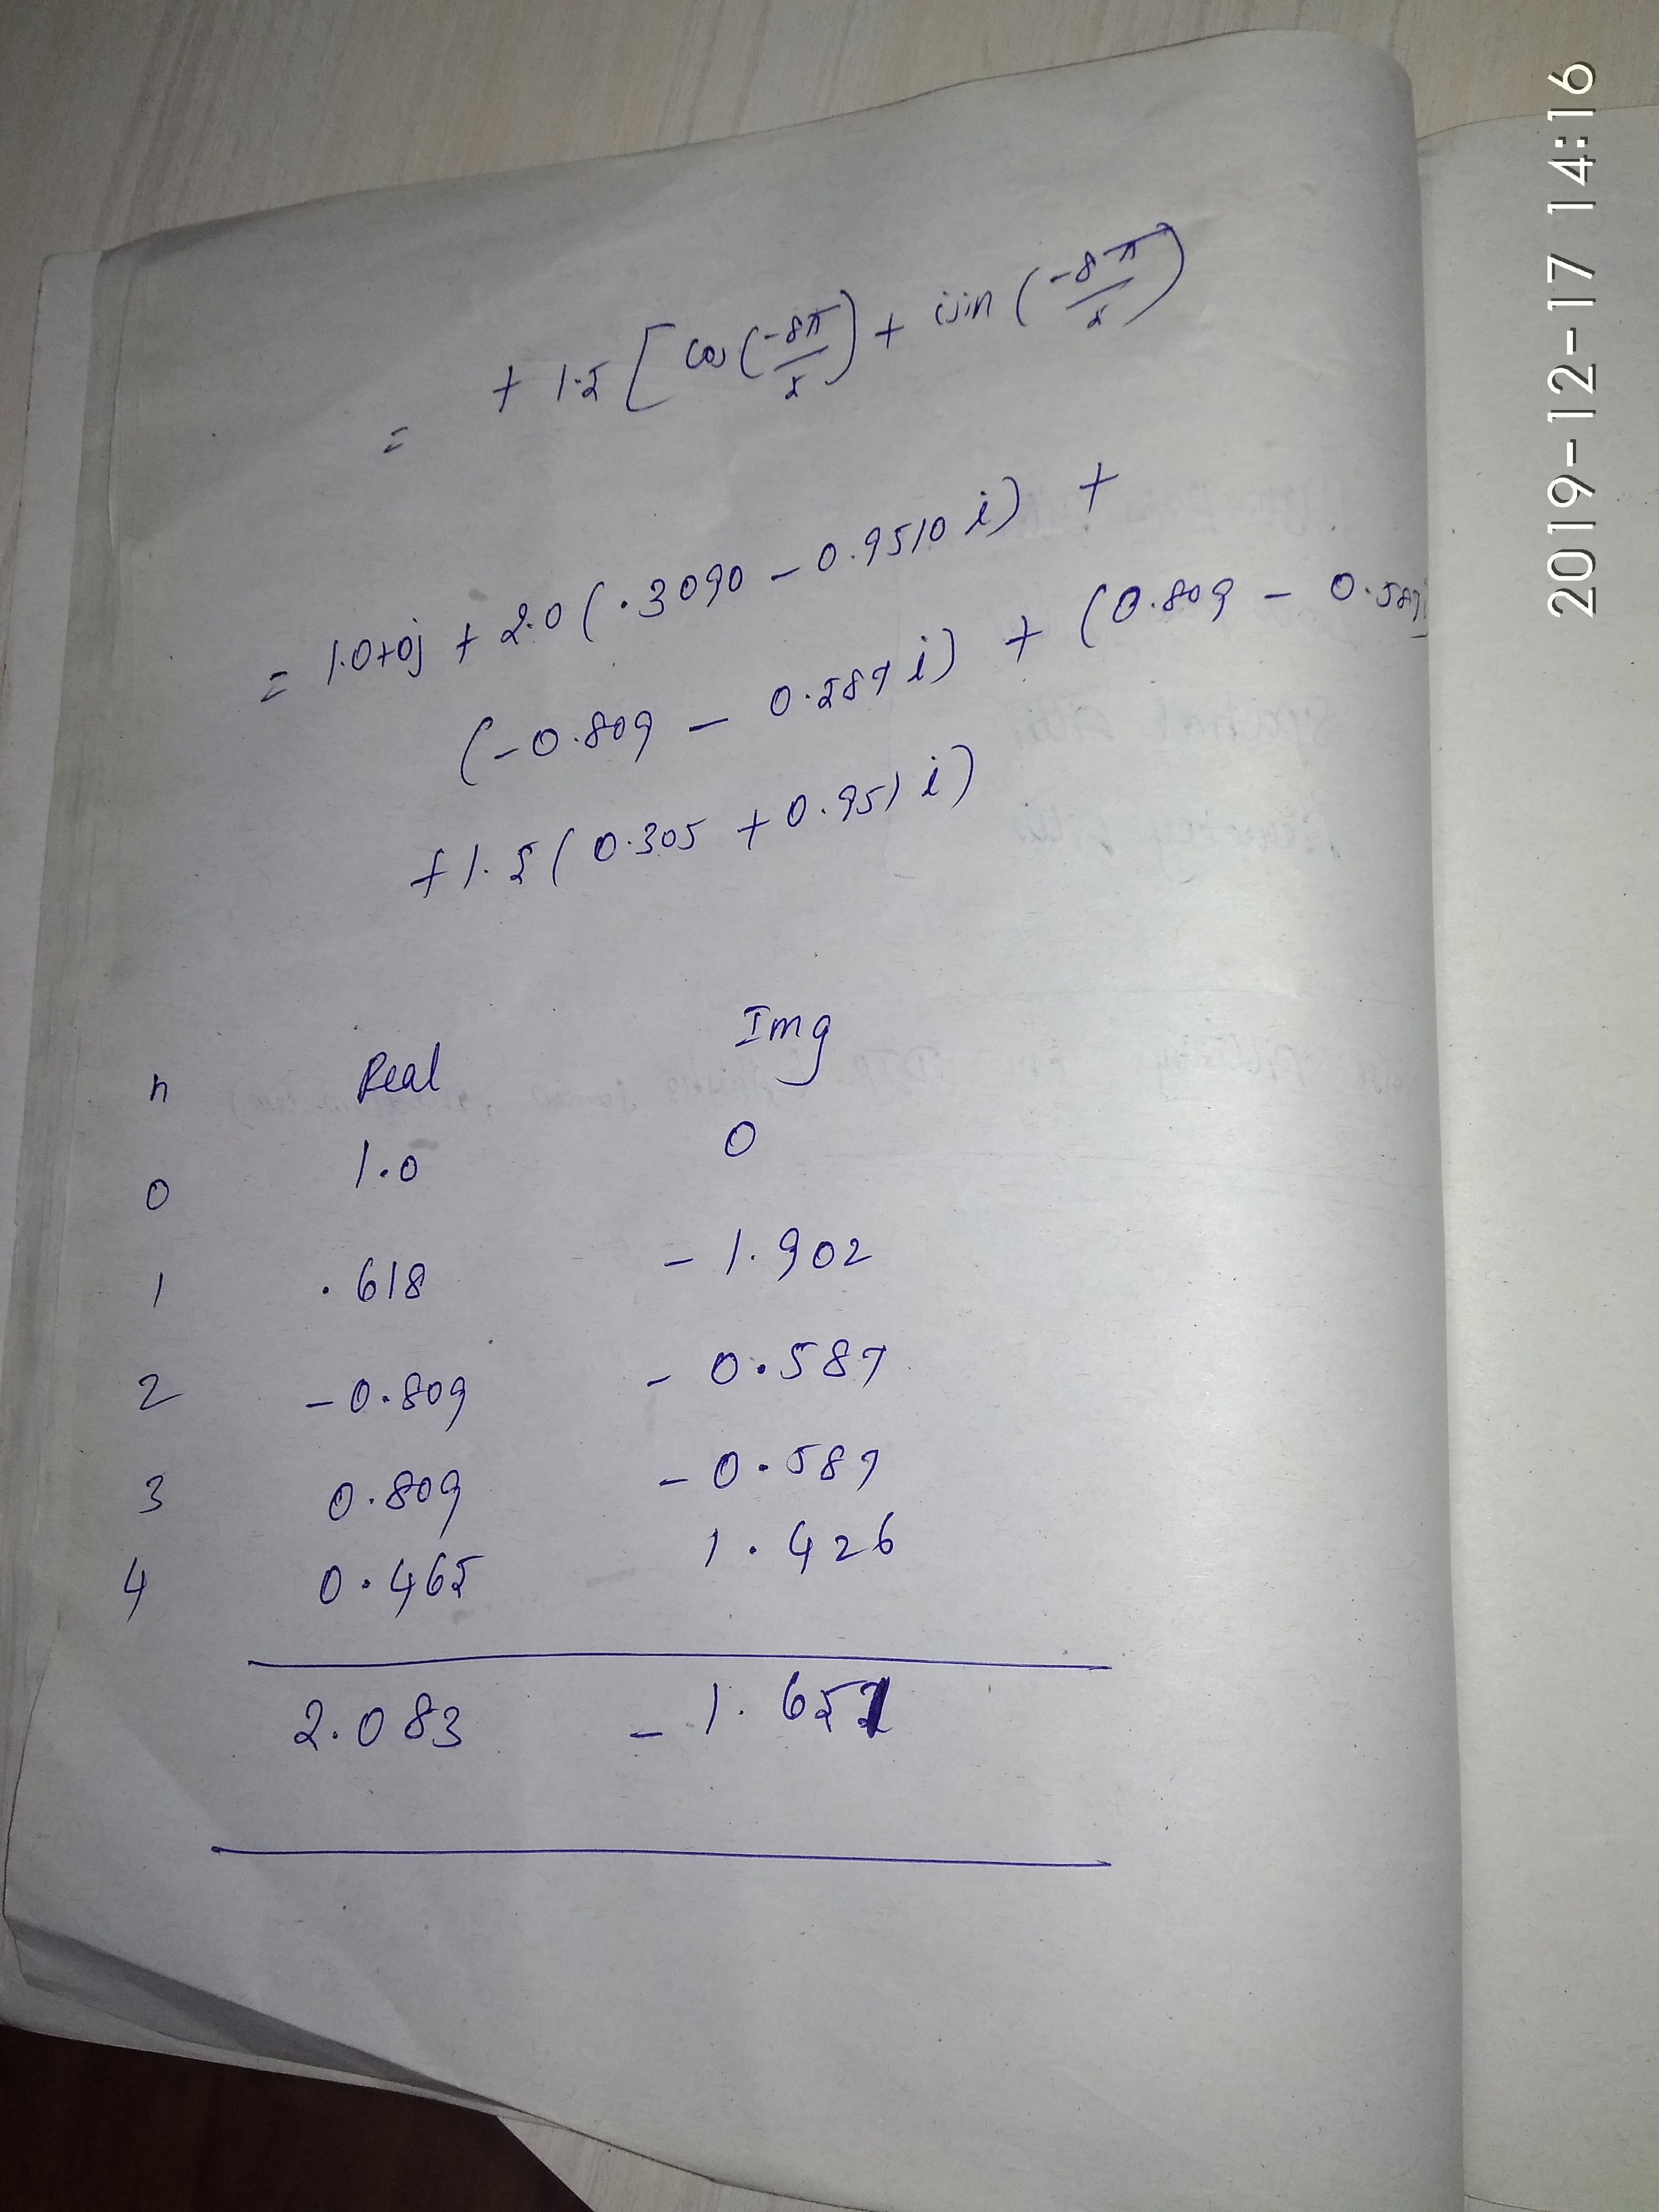

Slide 38
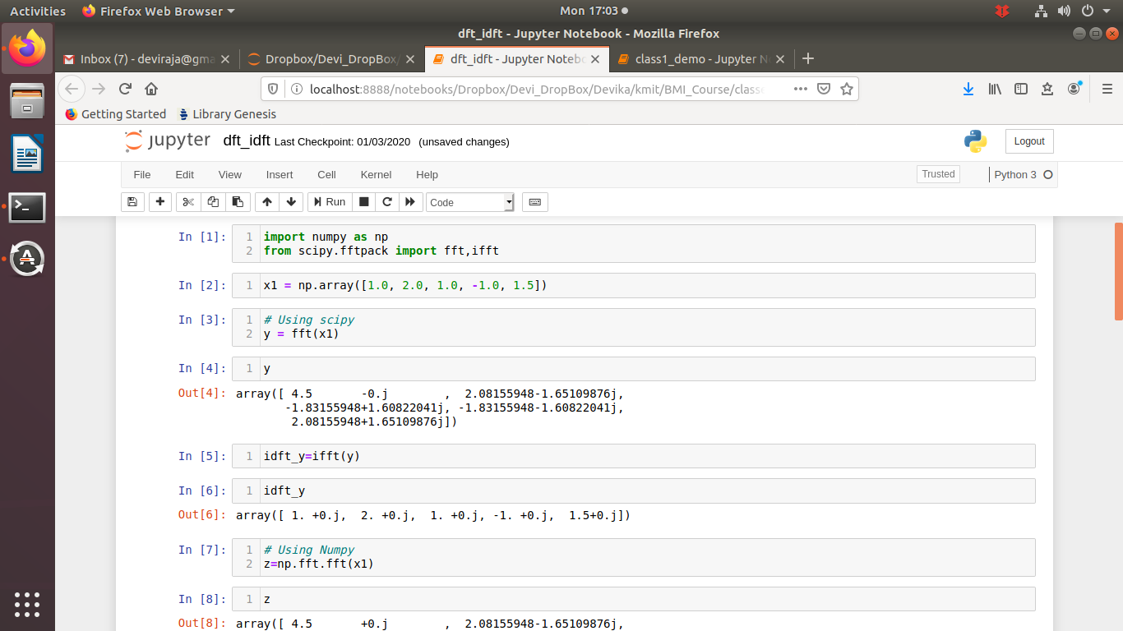
One dimensional FFT

Slide 39
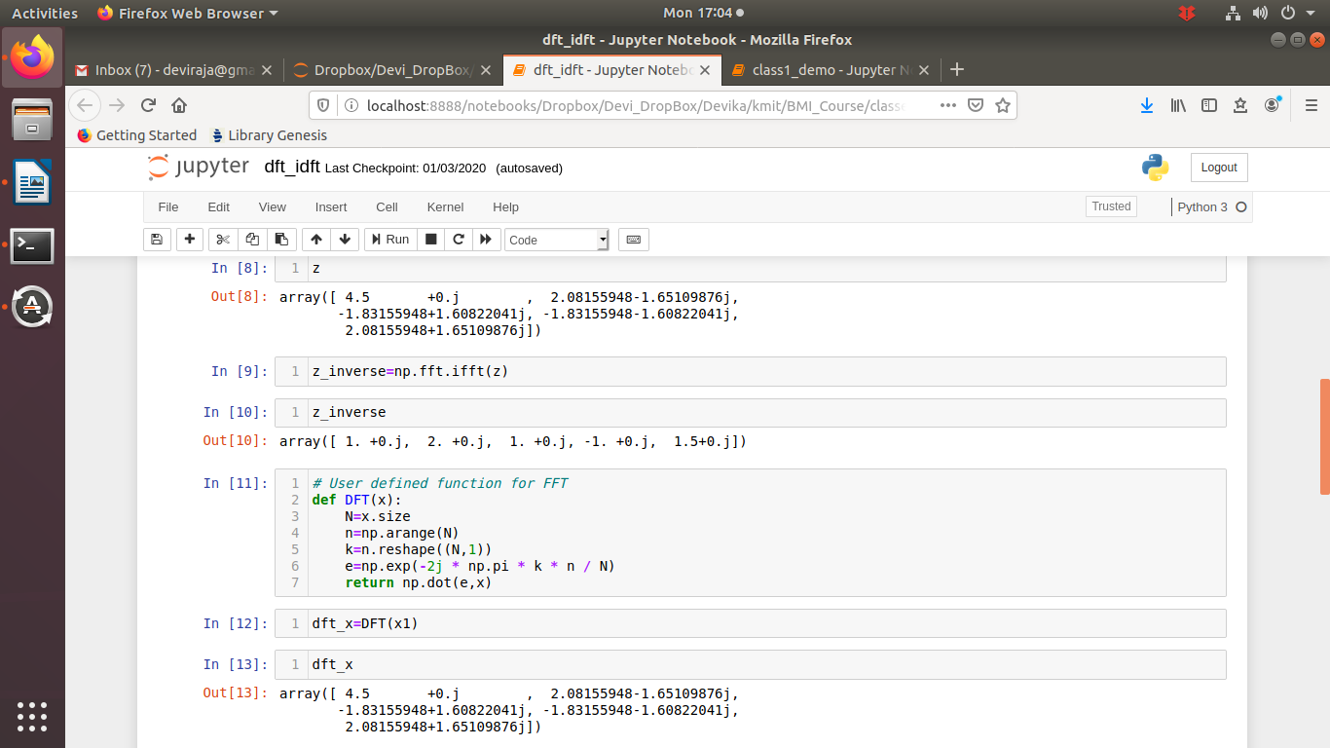
One dimensional FFT

Slide 40
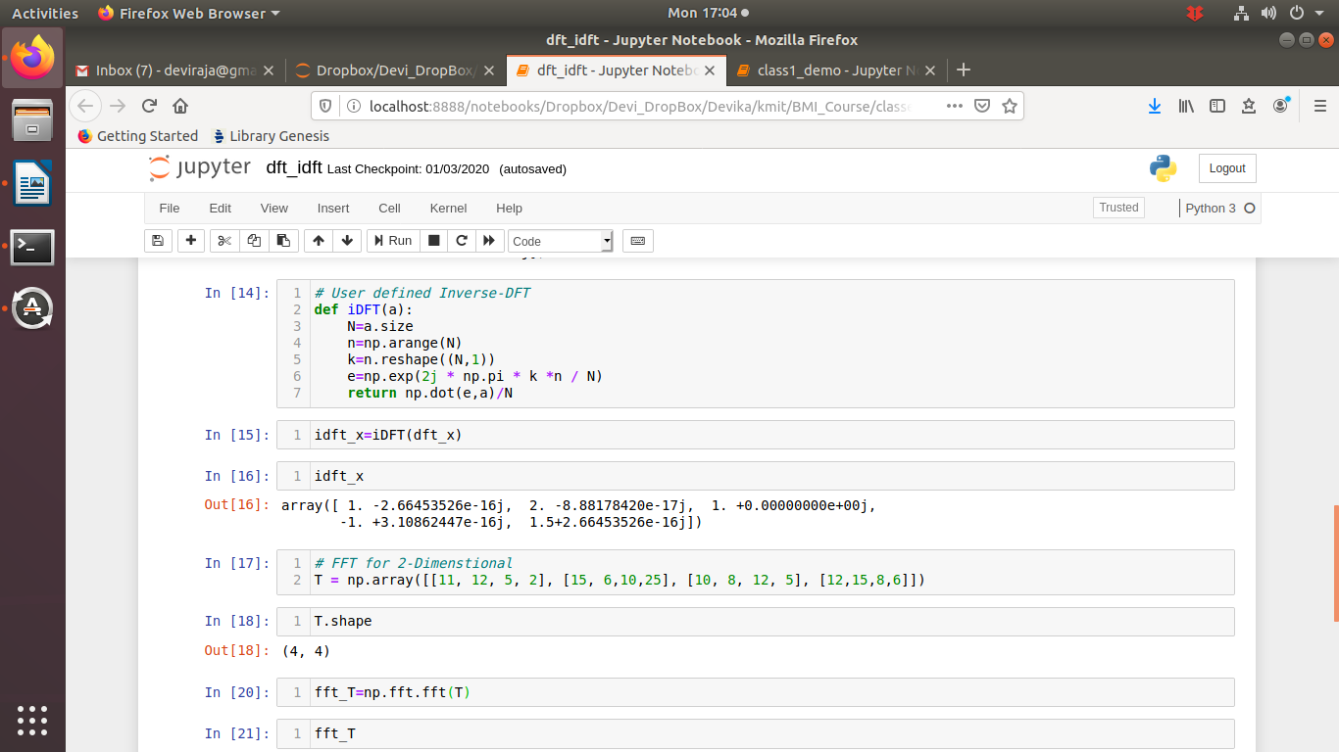
One dimensional FFT

Slide 41
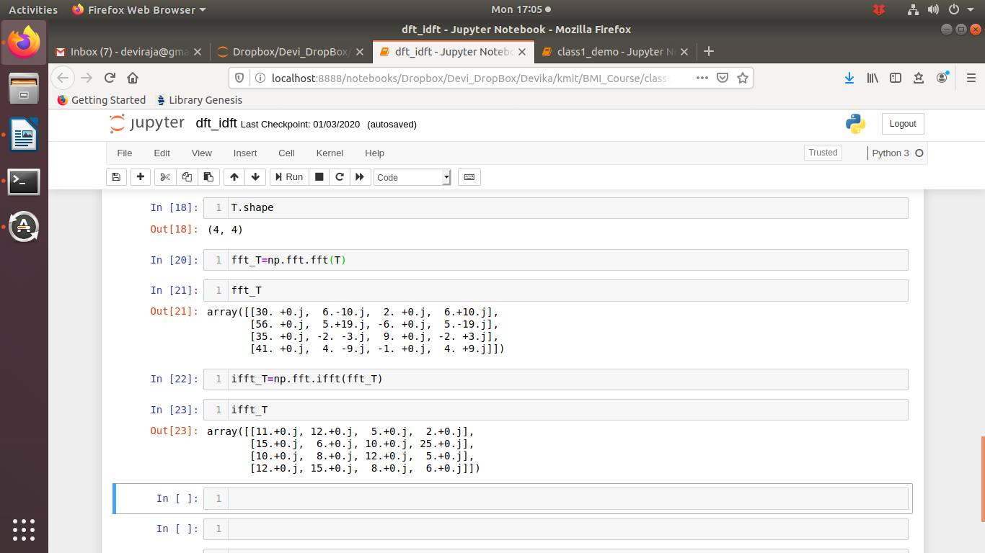
One dimensional FFT

Slide 42
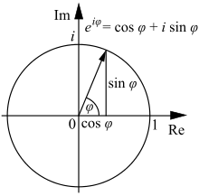
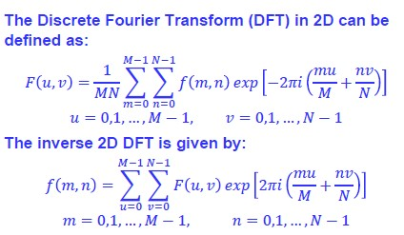
Discrete Fourier Transform (DFT)
Where F(u,v) is the frequency domain image, M,N are maximum intensity values of the input image f(m,n)
dft_idft.ipynb

Slide 43
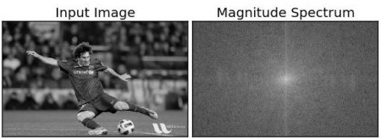
Discrete Fourier Transform (DFT)
Input Image f(x,y)
Fourier
Transform
Magnitude
Spectrum
Inverse
Transform
Magnitude_fft.ipynb

Slide 44
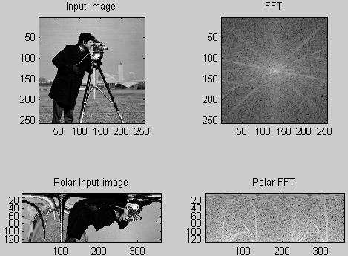
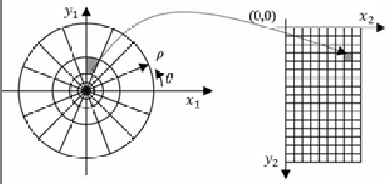
FFT and Polar FFT

Slide 45
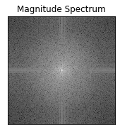
Spectrum Image - Inference
F(0,0) represents average brightness of the input image, which present either in the Top-Left Or Center (By Shift Operator) of the magnitude spectrum image
F(N-1, N-1) represents the highest frequency of the input image in the magnitude spectrum image

Slide 46
Spatial Domain vs Frequency Domain
The Fourier Transform converts spatial image data into a frequency representation
Both representations contain equivalent information
Spatial Domain Frequency Domain
Intuitive Representation Non-intuitive representation
Designing filters can be hard Designing filters often easier
Filtering with large kernels may result Filtering with large kernels can
in long processing times be performed very quickly
Kernels applied directly to spatial data Image and Kernel must first be
converted to frequency domain
modified, then reconverted

Slide 47
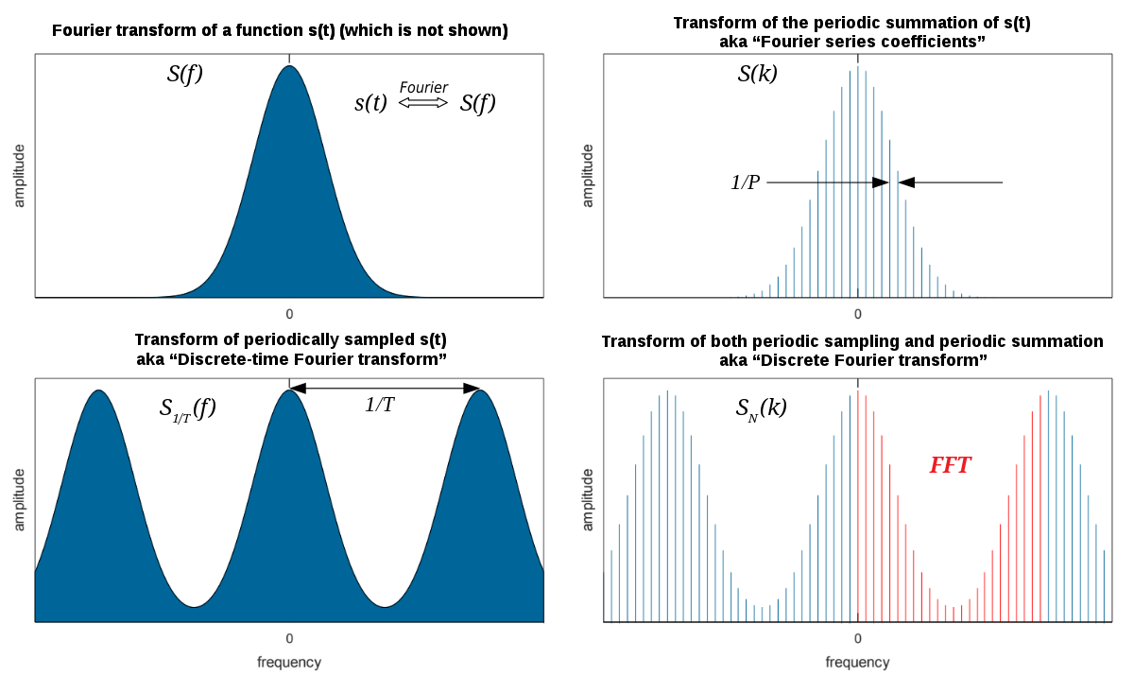
Spatial Domain vs Frequency Domain

Slide 48
Spectrum Image - Inference
F(0,0) represents average brightness of the input image, which present either in the Top-Left Or Center (By Shift Operator) of the magnitude spectrum image
F(N-1, N-1) represents the highest frequency of the input image in the magnitude spectrum image

Slide 49
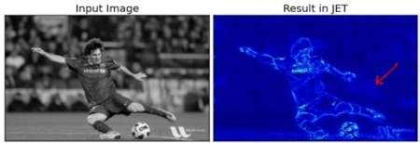
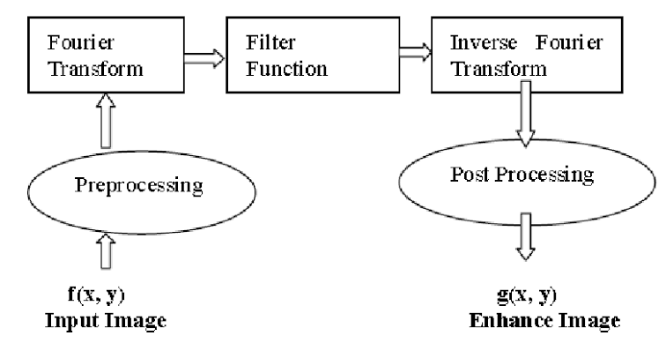
Discrete Fourier Transform (DFT)

Slide 50
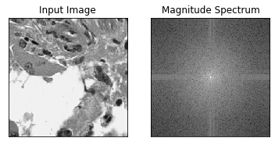
Forward DFT
import cv2
import numpy as np
from matplotlib import pyplot as plt
f = np.fft.fft2(gray)
fshift = np.fft.fftshift(f)
magnitude_spectrum = 20*np.log(np.abs(fshift))
plt.subplot(121),plt.imshow(gray, cmap = 'gray')
plt.title('Input Image'), plt.xticks([]), plt.yticks([])
plt.subplot(122),plt.imshow(magnitude_spectrum, cmap = 'gray')
plt.title('Magnitude Spectrum'), plt.xticks([]), plt.yticks([])
plt.show()

Slide 51
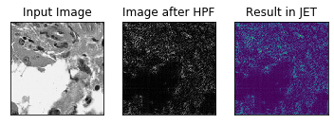
Inverse DFT
rows, cols =gray.size
crow,ccol = int(rows/2) , int(cols/2)
fshift[crow-30:crow+30, ccol-30:ccol+30] = 0
f_ishift = np.fft.ifftshift(fshift)
img_back = np.fft.ifft2(f_ishift)
img_back = np.abs(img_back)
plt.subplot(131),plt.imshow(gray, cmap = 'gray')
plt.title('Input Image'), plt.xticks([]), plt.yticks([])
plt.subplot(132),plt.imshow(img_back, cmap = 'gray')
print(rows,cols)
plt.title('Image after HPF'), plt.xticks([]), plt.yticks([])
plt.subplot(133),plt.imshow(img_back)
plt.title('Result in JET'), plt.xticks([]), plt.yticks([])
plt.show()

Slide 52
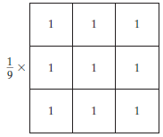
Kernel/Mask/Filter
A lot of times in texts/research papers/books related to image processing, use the terms mask, kernel, and filter interchangeably
“Is a square matrix of numbers that is used to compute various properties or characteristics in an image”
Average Kernel
Convolution:
“Is defined as the sum of the product of the corresponding elements of a kernel matrix to an image matrix”

Slide 53
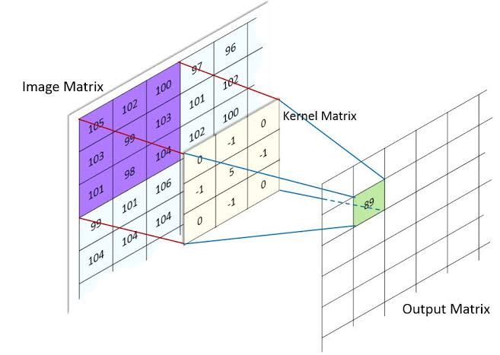
Image Convolution
Output Matrix = Sum of the product of corresponding elements of image matrix with Kernel Matrix
-102-103+495-103-98 = 89

